Slide 1
Project: Database design and query language
Members:
Nguyễn Hoàng Vũ – 18IT1 Team leader
Phan Thành Đạt – 18IT1 Team member
Quách Trọng Thái – 18IT1 Team member
Content: Design a database for a electronic webshop (selling laptop,phone,….) and write query sentence for features DBMS: PostgreSQL

Slide 2
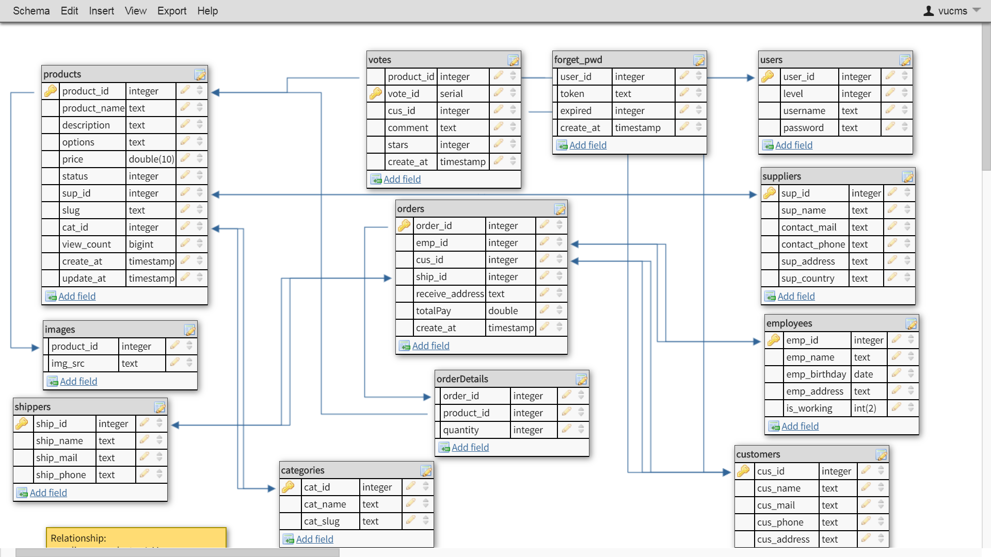
Database structure

Slide 3
Relationships
suppliers -> products : 1-M
products -> suppliers: 1-1
Products -> images : 1-M
categories -> products:1-M
Products -> categories: 1-1
Orders -> employees: 1-1
Orders -> orderDetails: 1-M
orderDetails -> products: 1-1
Orders -> customers: 1-1
Customers -> orders: 1-M
Employees -> orders: 1-M
shippers -> orders: 1-M
Orders -> shippers: 1-1
Products -> votes: 1-M
Forget_pwd ->users:1-1
Votes->cusomer:1-1
Votes-> products: 1-1

Slide 4
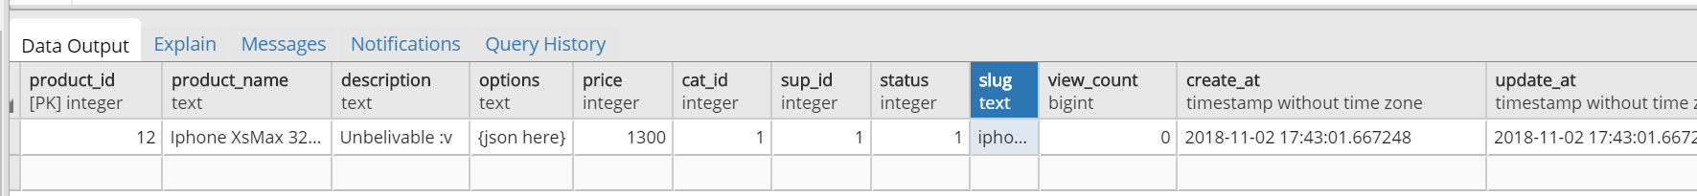
Query Insert
Insert new products into table products INSERT INTO public.products(
product_id, product_name, description, options, price,
cat_id, sup_id, status, slug, view_count, create_at, update_at)
VALUES (12, 'Iphone XsMax 32gb', 'Unbelivable :v ', '{json here}', 1300, 1, 1, 1,'iphone-xsmax-32gb', 0, 'now()', 'now()');
Result:

Slide 5
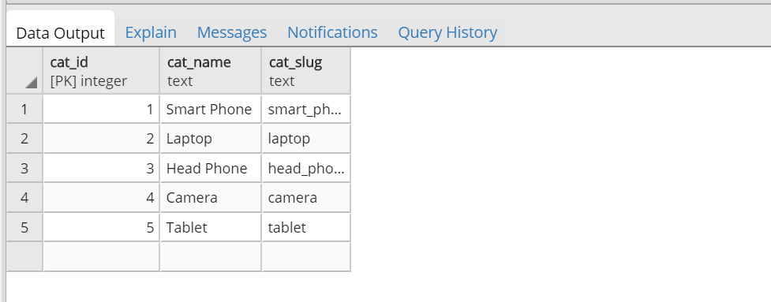
Query Insert
Insert a new category into categories list
INSERT INTO public.categories(
cat_id, cat_name, cat_slug)
VALUES (5, 'Tablet', 'tablet');

Slide 6
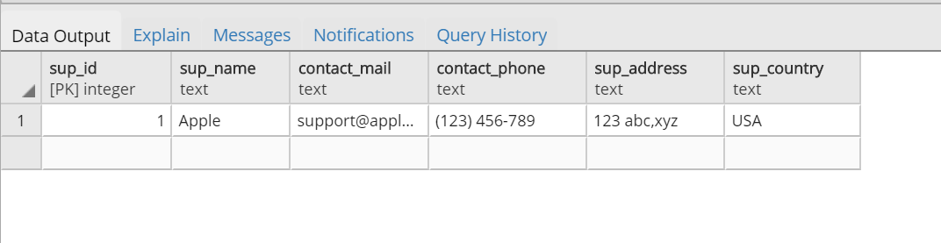
Query Insert
Insert new supplier into suppliers list
INSERT INTO public.suppliers(
sup_id, sup_name, contact_mail, contact_phone, sup_address, sup_country)
VALUES (1, 'Apple', 'support@apple.com', '(123) 456-789', '123 abc,xyz', 'USA');

Slide 7
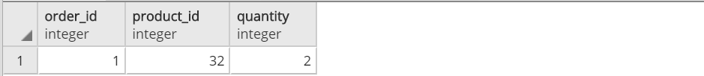
Query Insert
Insert new order into orders list
INSERT INTO public.orders(
order_id, emp_id, cus_id, ship_id, receive_address,”totalPay”, create_at)
VALUES (1, 1, 1, 1, '123 abc, xyz', 900, 'now()');
INSERT INTO public.”orderDetails”(
order_id, product_id, quantity)
VALUES (1, 32, 2);

Slide 8
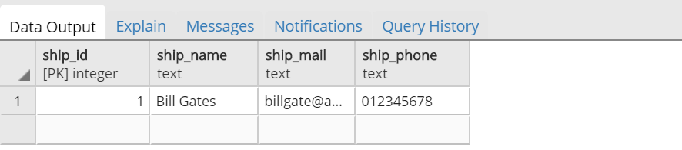
Query Insert
Insert new shipper into shippers list
INSERT INTO public.shippers(
ship_id, ship_name, ship_mail, ship_phone)
VALUES (1, 'Bill Gates', 'billgate@abc.com', '012345678');

Slide 9
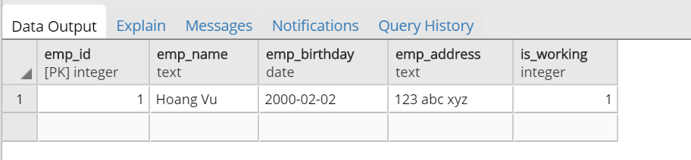
Query Insert
Insert new employee into employees list
INSERT INTO public.employees(
emp_id, emp_name, emp_birthday, emp_address, is_working)
VALUES (1, 'Hoang Vu', '02-02-2000', '123 abc xyz', 1);

Slide 10
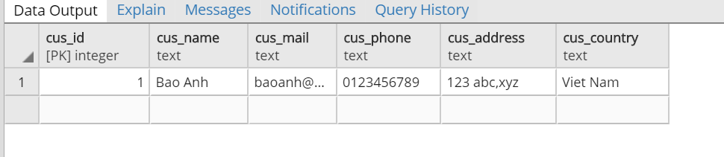
Query Insert
Insert new customer into customers list
INSERT INTO public.customers(
cus_id, cus_name, cus_mail, cus_phone, cus_address, cus_country)
VALUES (1, 'Bao Anh', 'baoanh@abc.com', '0123456789', '123 abc,xyz', 'Viet Nam');

Slide 11
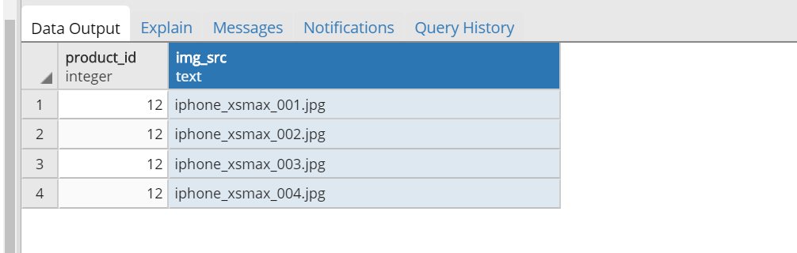
Query Insert
Insert images for products
INSERT INTO public.images(
product_id, img_src)
VALUES (12, 'iphone_xsmax_001.jpg'),(12, 'iphone_xsmax_002.jpg'),(12, 'iphone_xsmax_003.jpg') ,(12, 'iphone_xsmax_004.jpg');

Slide 12
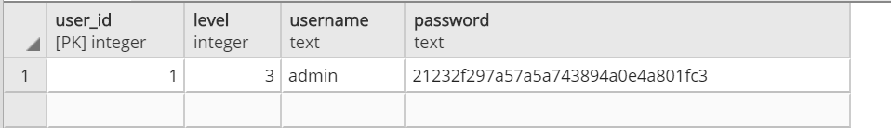
Query Insert
Insert new user into users list (Register)
INSERT INTO public.users(
user_id, level, username, password)
VALUES (1, 3, 'admin', MD5('admin'));

Slide 13
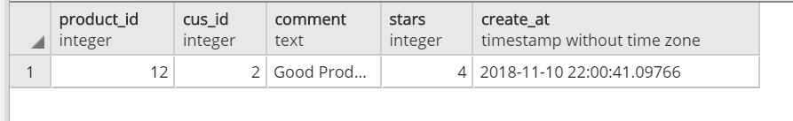
Query Insert
Insert new vote into votes list
INSERT INTO public.votes(
product_id, cus_id, comment, stars, create_at)
VALUES (12, 2, 'Good Product', 4, 'now()');

Slide 14
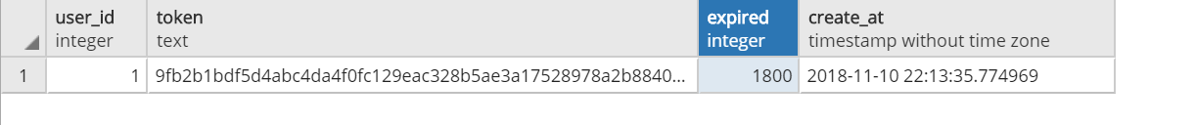
Query Insert
Create new token for reset password
INSERT INTO public.forget_pwd(
user_id, token, expired, create_at)
VALUES (1, CONCAT(md5(random()::text),md5(random()::text),
md5(random()::text)), 1800, 'now()');

Slide 15
Query Insert

Slide 16
Query Insert

Slide 17
Query Insert

Slide 18
Query Insert

Slide 19
Query Insert
Create new token for r

Slide 20
Query Insert
Create new token for r

Slide 21
Query Insert
Create new token for r

Slide 22
Query Insert
Create new token for r

Slide 23
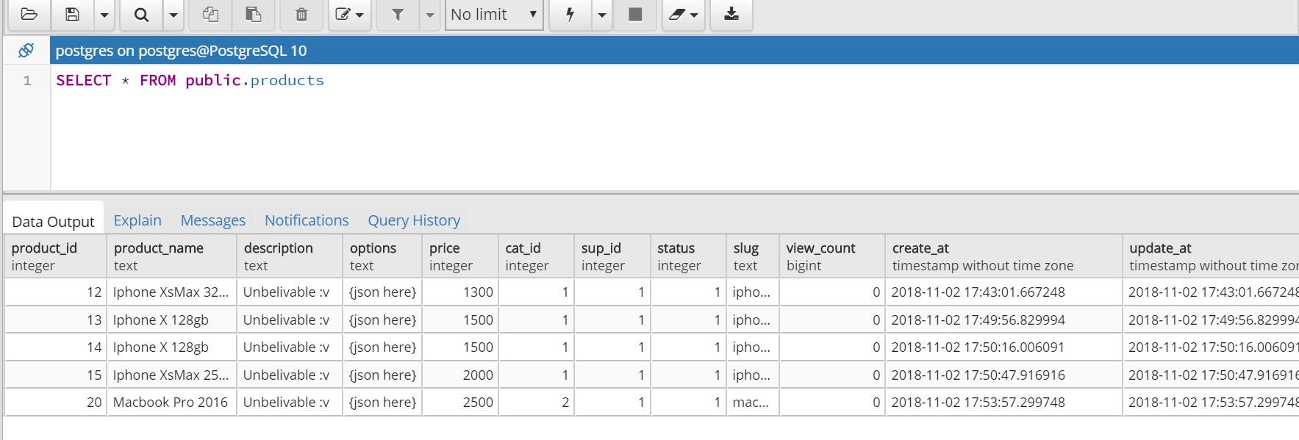
Query Select
Select informations of all products in table products

Slide 24
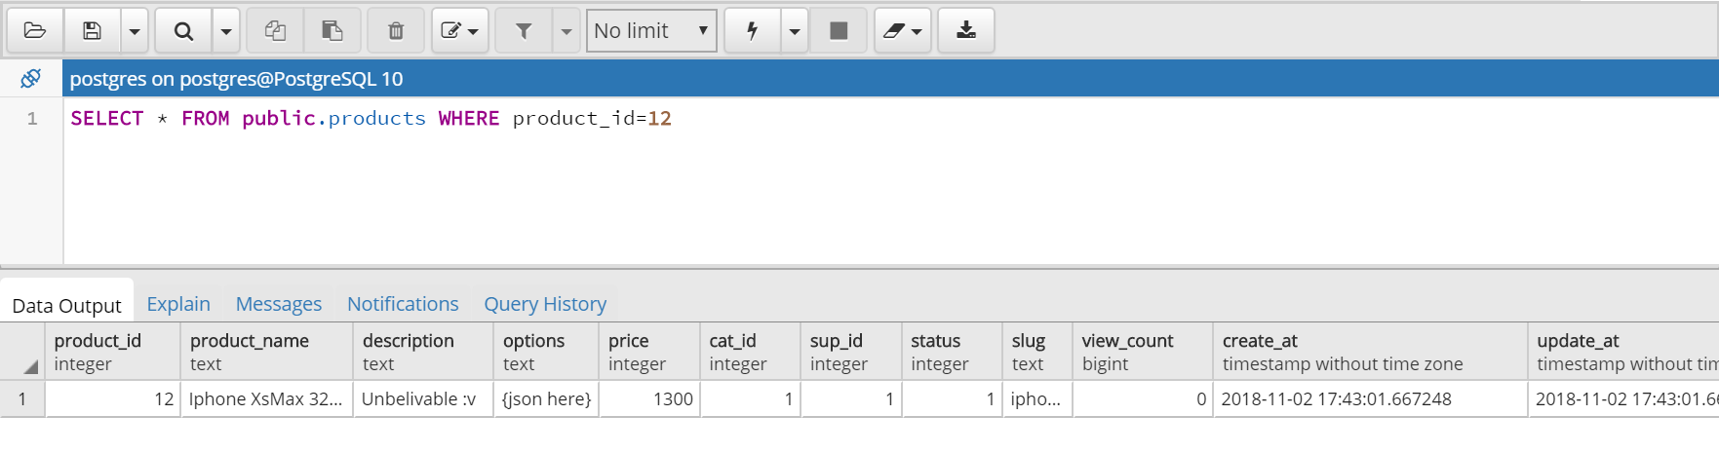
Query Select
Select informations of a product in table products by product_id (Primary Key)

Slide 25
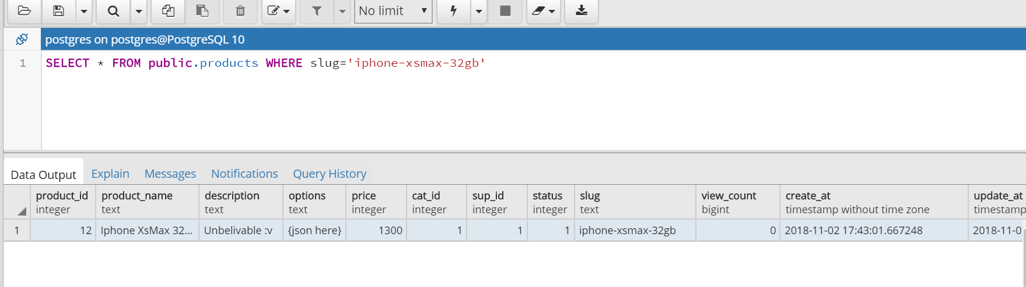
Query Select
Select informations of a product in table products by slug (unique)

Slide 26
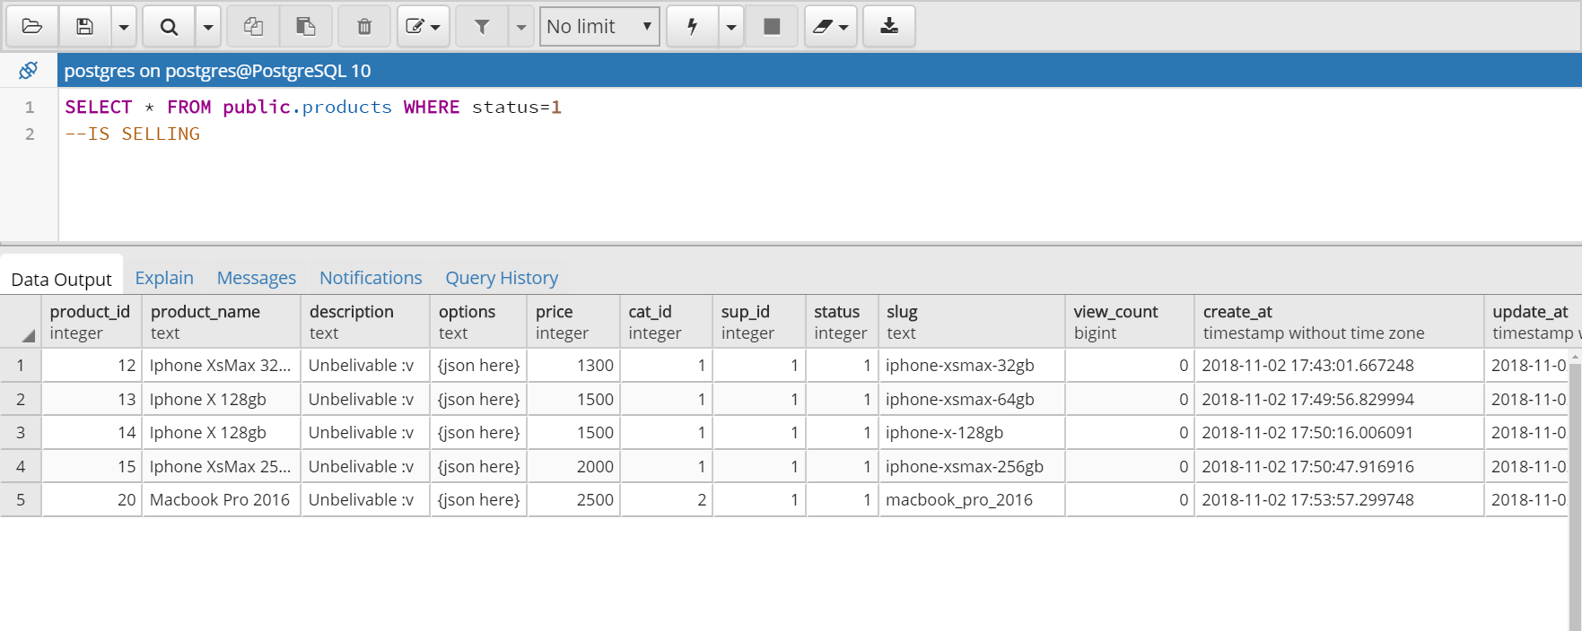
Query Select
Select all products which are selling status==1 => selling status==0 => stop selling

Slide 27
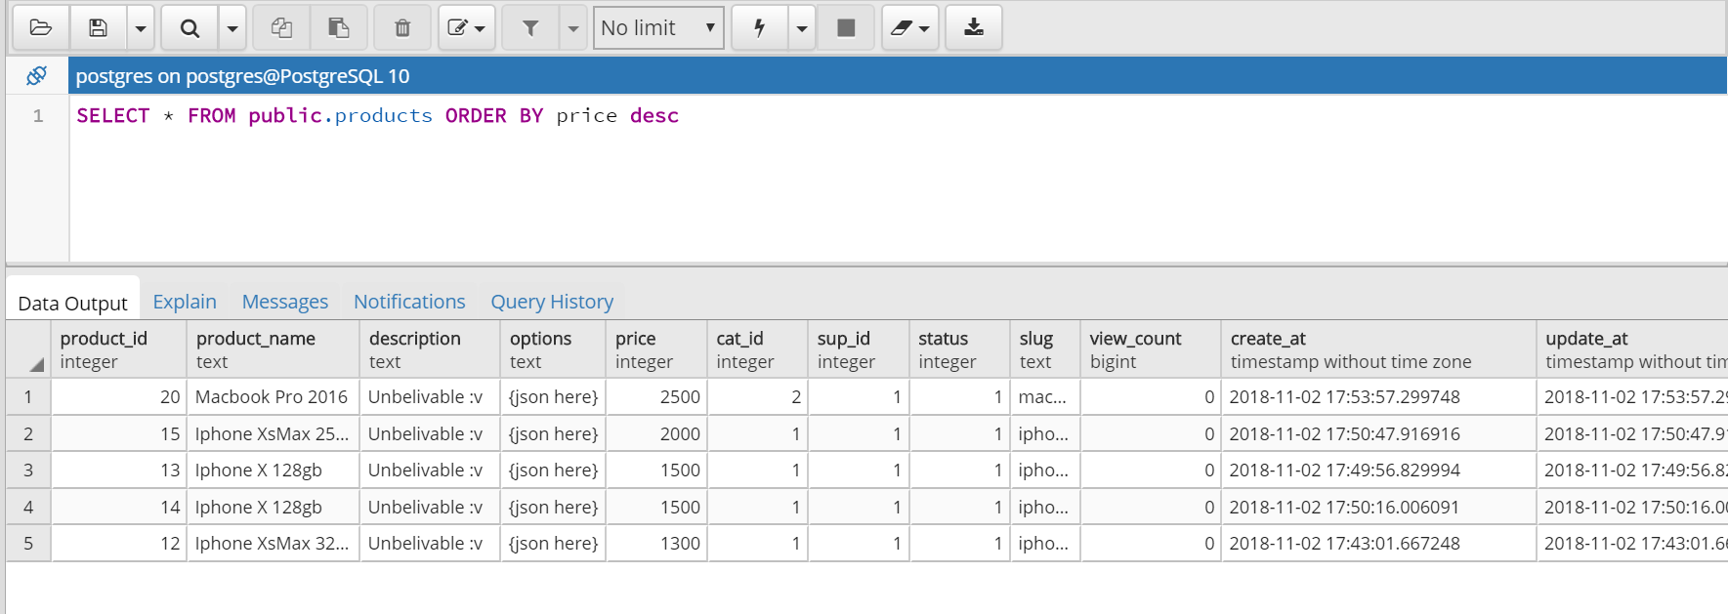
Query Select
Select all informations of products and sort it by Price (Example : high to low)

Slide 28
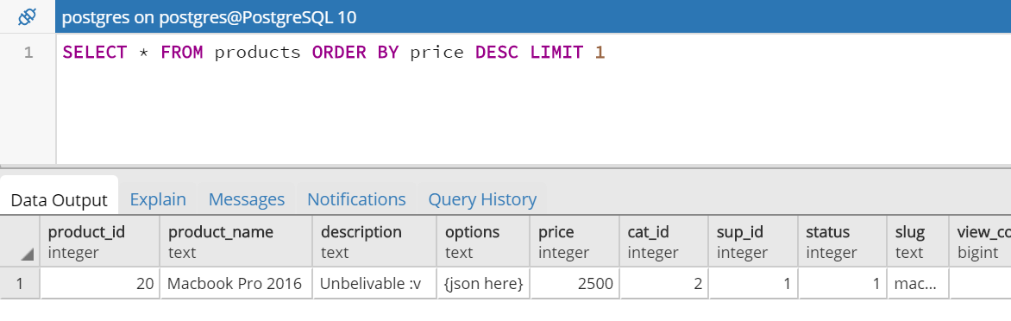
Query Select
Select all informations of product which have highest price

Slide 29
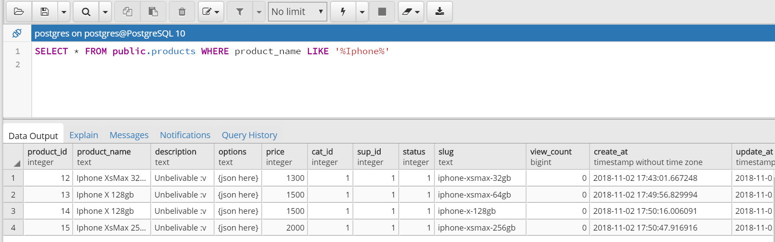
Query Select
Search informations of products by keyword

Slide 30
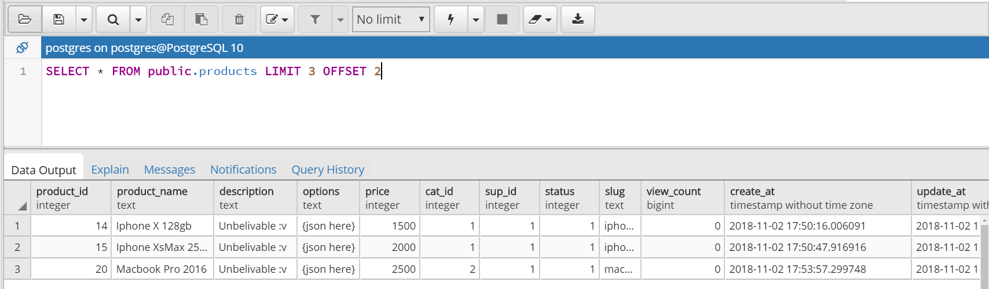
Query Select
Search informations of products with limit and offset (for pagination)

Slide 31
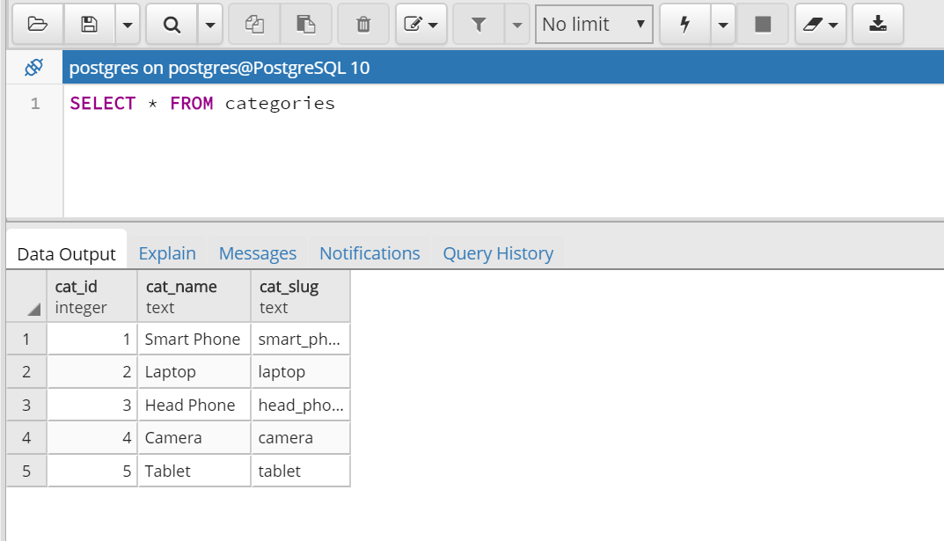
Query Select
Select all categories in categories list

Slide 32
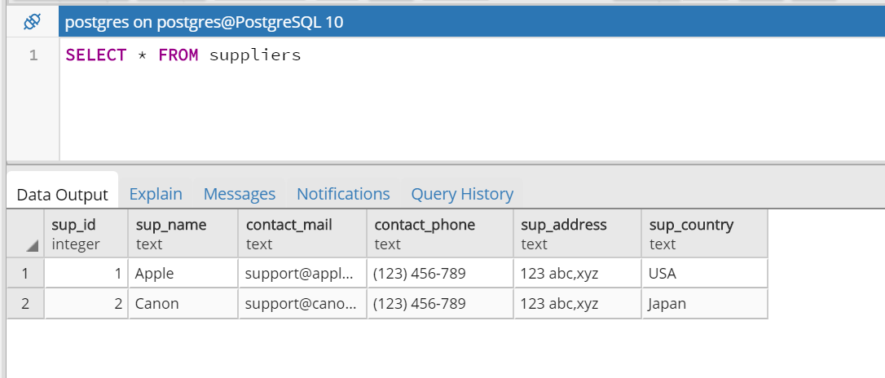
Query Select
Select information of all suppliers in suppliers list

Slide 33
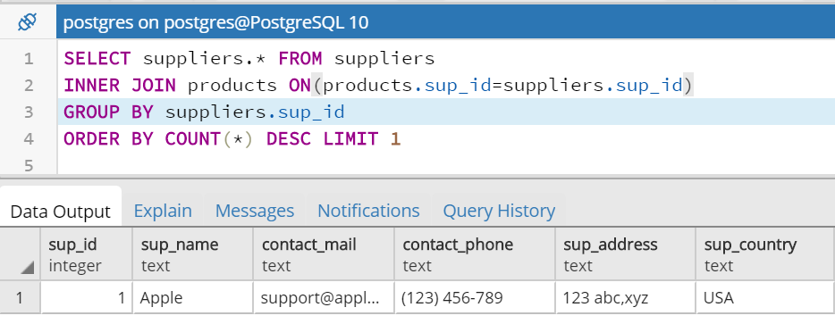
Query Select
Select information of supplier which supplied the most products

Slide 34
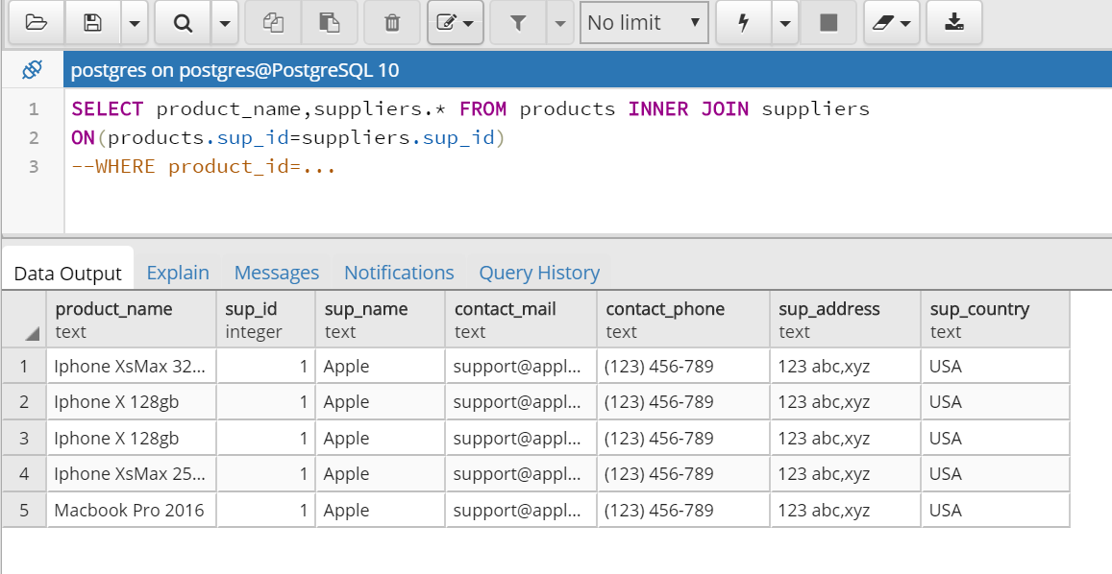
Query Select
Select supplier informations of any products

Slide 35
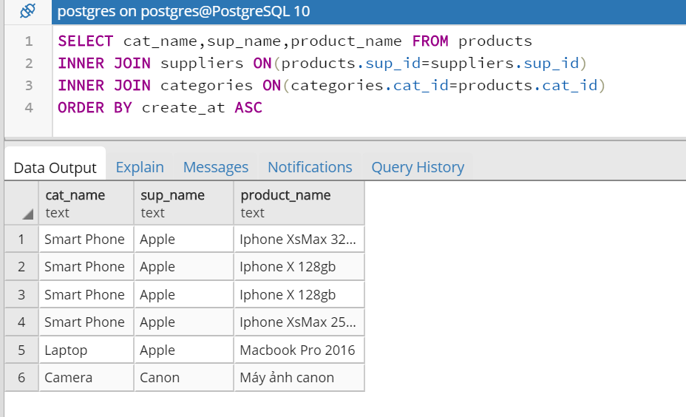
Query Select
Select category name and supplier name of any products

Slide 36
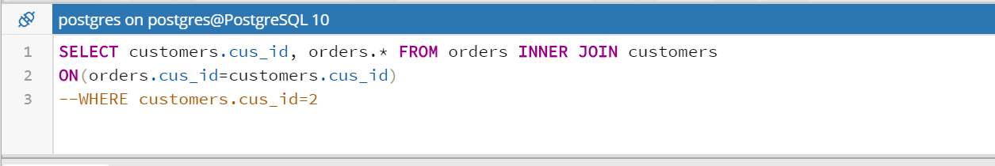
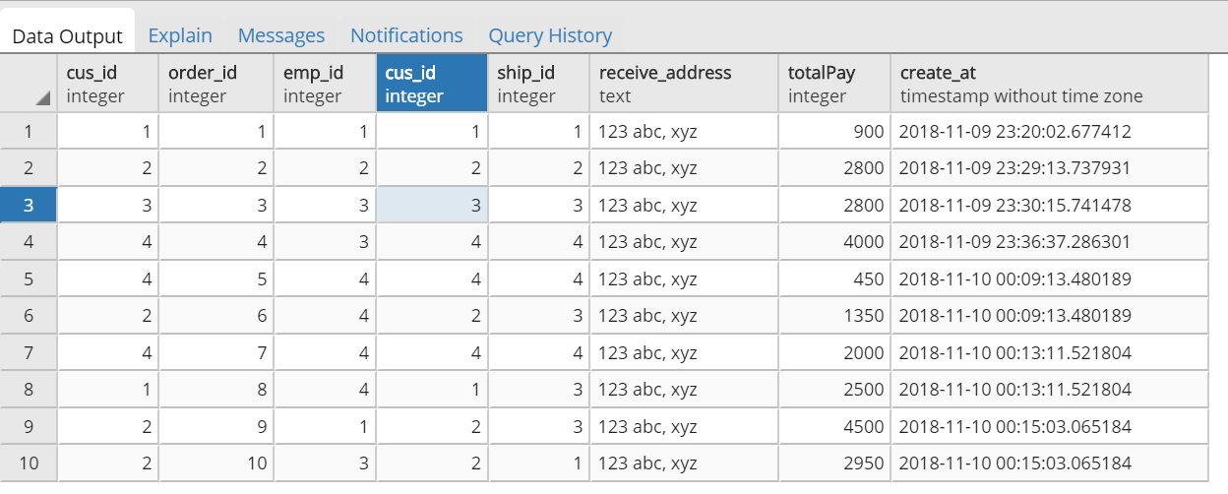
Query Select
Select information orders are bought by any customers

Slide 37
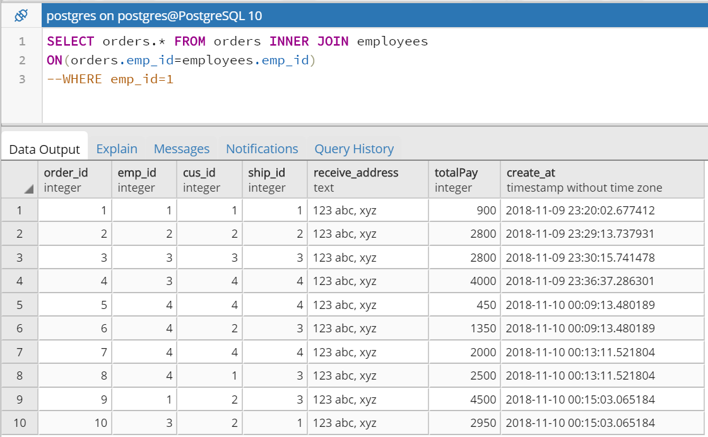
Query Select
Select information orders are sold by any employees

Slide 38
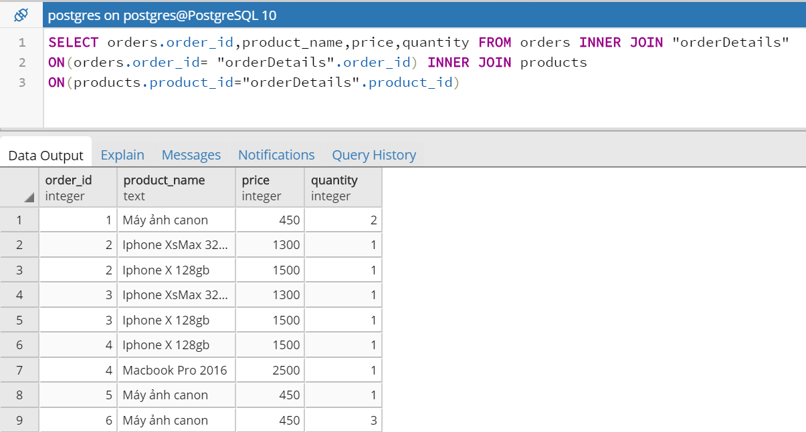
Query Select
Select information of products(name,quantity,price or more) in a order

Slide 39
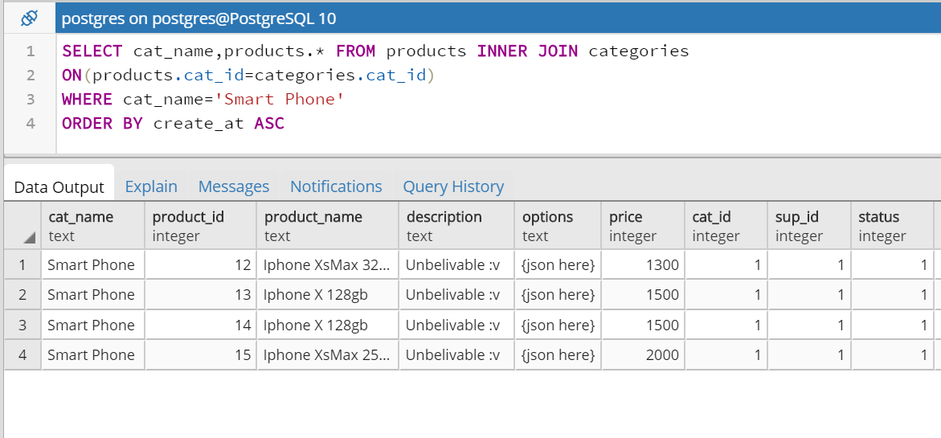
Query Select
Select all products in a category (Example : Smart Phone)

Slide 40
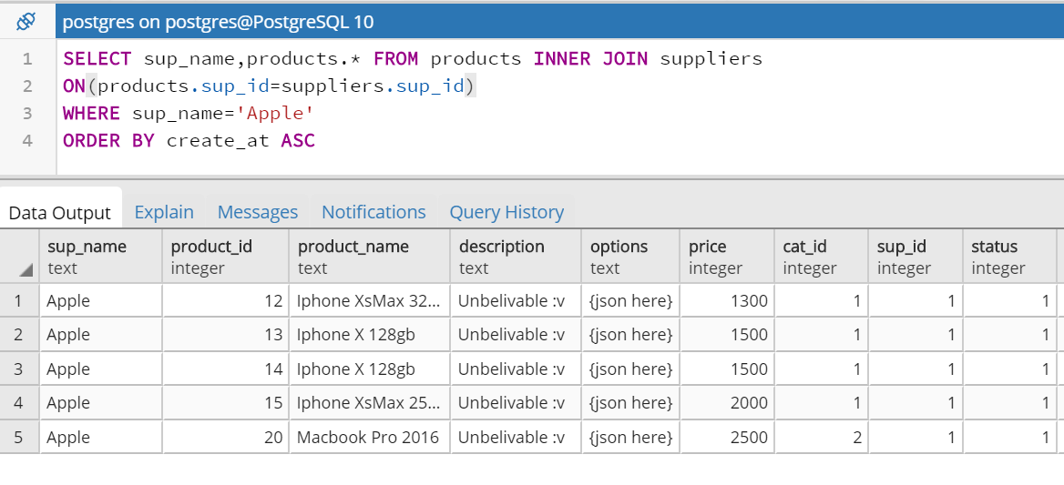
Query Select
Select all products which are supplied by a supplier
(Example : Apple)

Slide 41
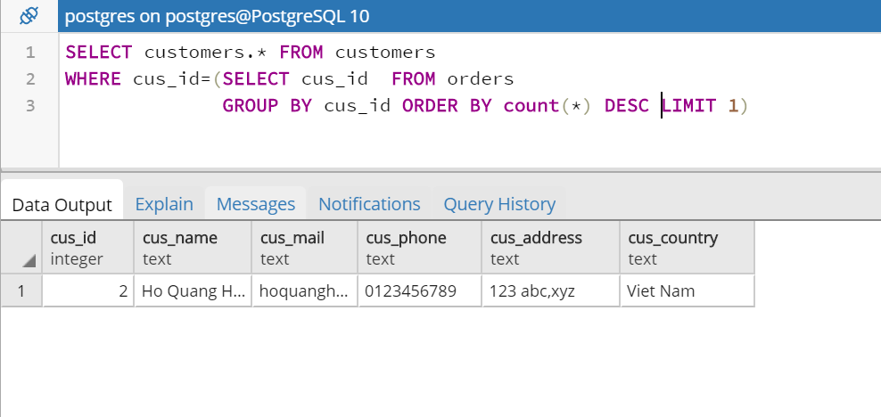
Query Select
Select customer who buy the most

Slide 42
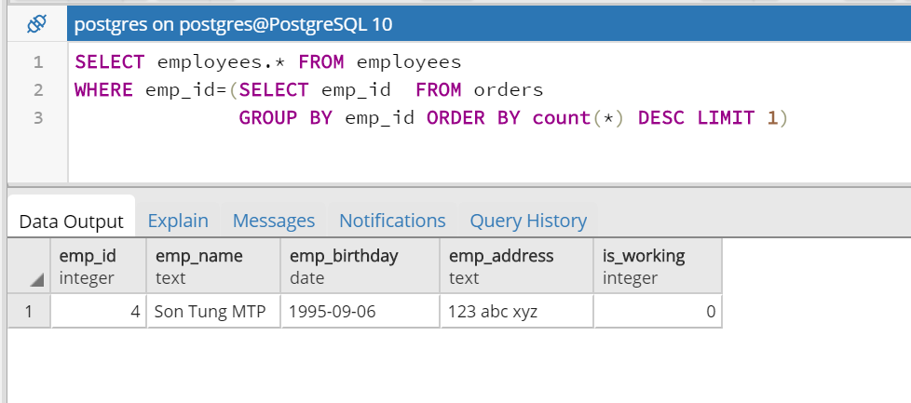
Query Select
Select employee who sell the most

Slide 43
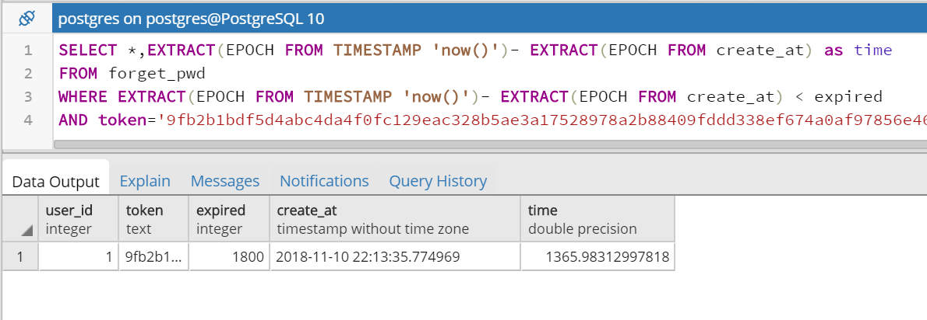
Query Select
Check the valid of reseting password by token and time

Slide 44
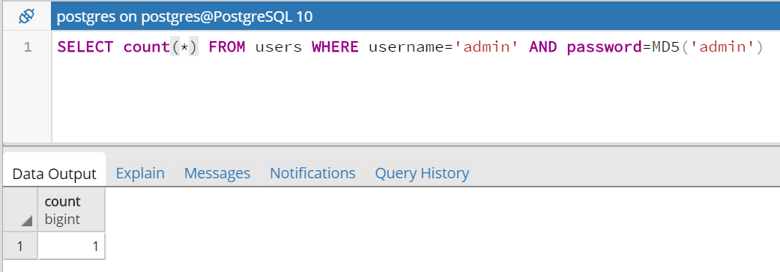
Query Select
Check the available of account when login

Slide 45
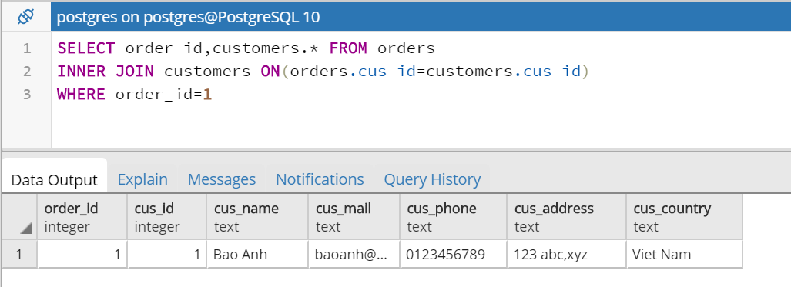
Query Select
Select information of customer who buy order (order_id=1)

Slide 46
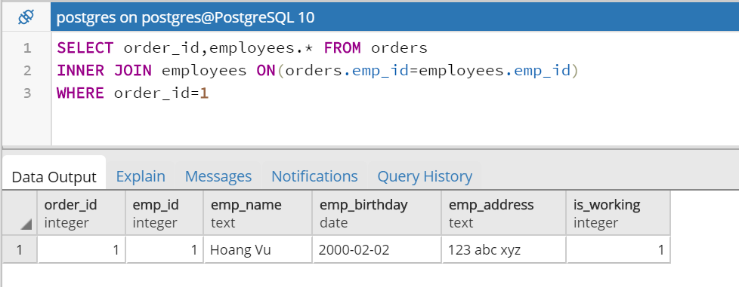
Query Select
Select information of employee who sell order (order_id=1)

Slide 47
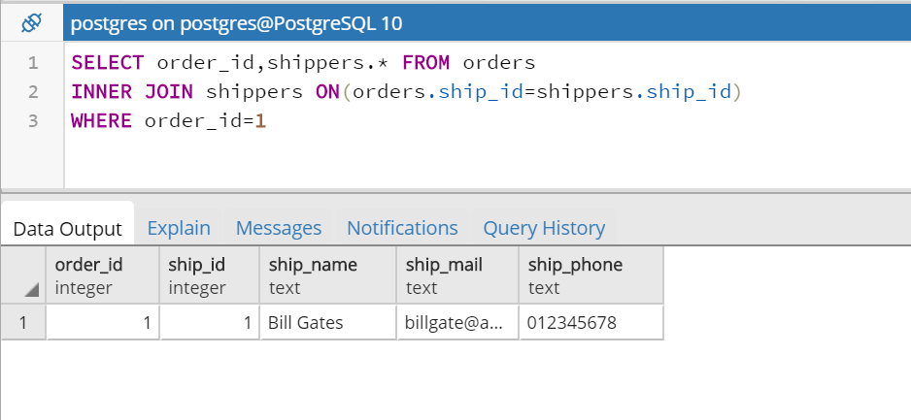
Query Select
Select information of shipper who ship order (order_id=1)

Slide 48
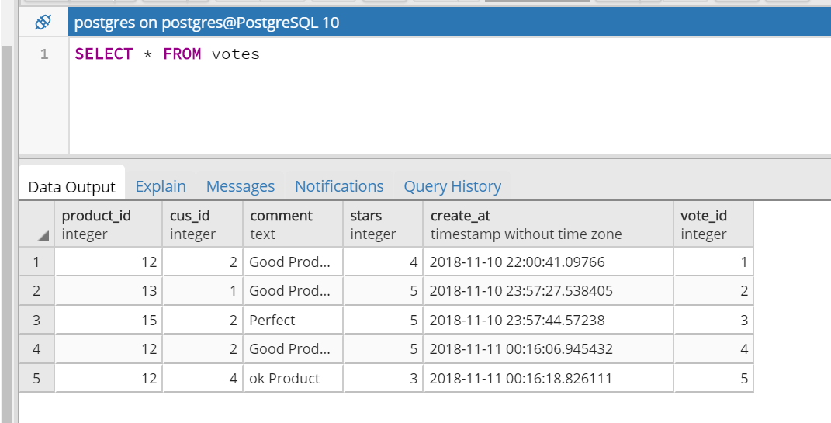
Query Select
Select all reviews in database

Slide 49
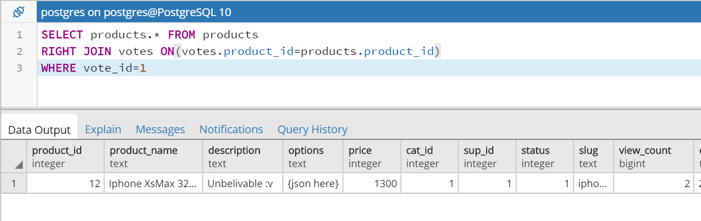
Query Select
Select information of products which were voted
Example: vote_id=1

Slide 50
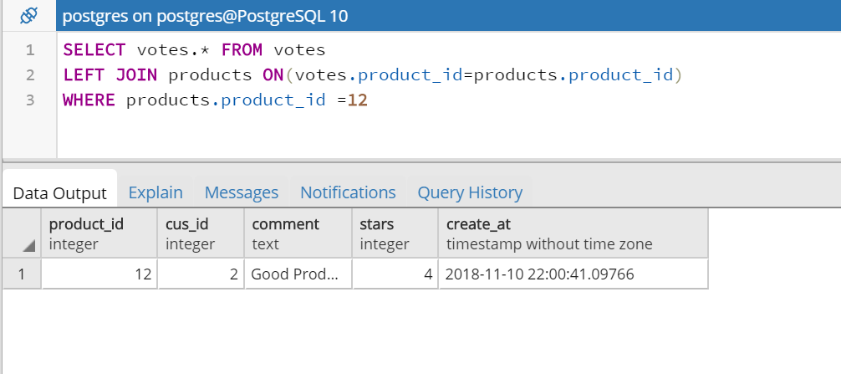
Query Select
Select reviews about product A (Example : product_id=12)

Slide 51
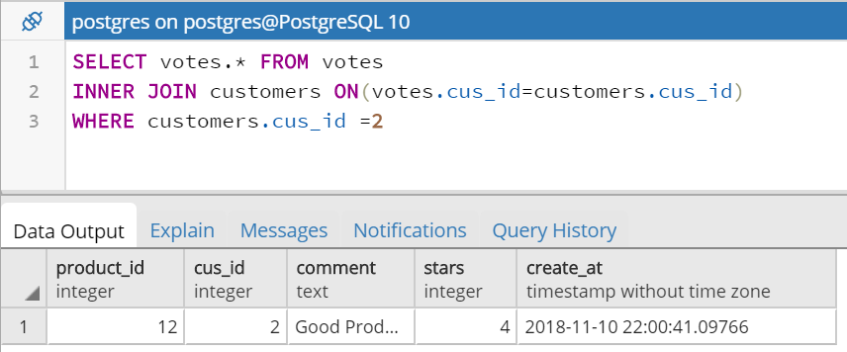
Query Select
Select all reviews were wrote by any customers (Example: cus_id =2)

Slide 52
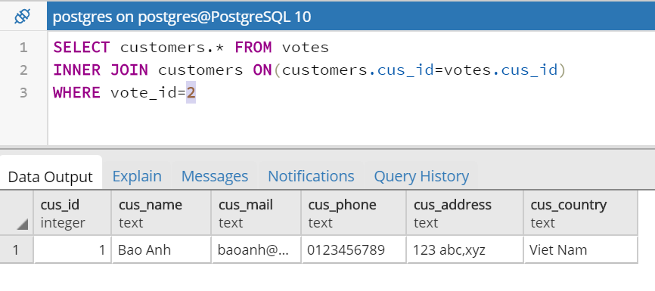
Query Select
Select information of customers who write this reviews
Example vote_id=2

Slide 53
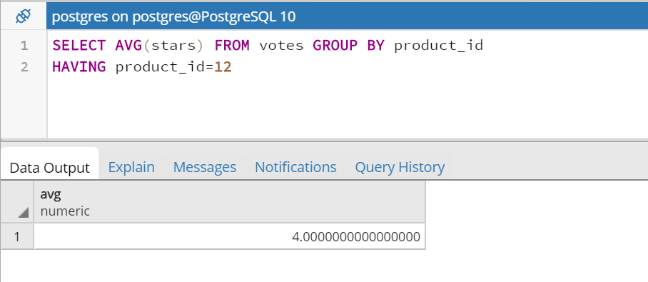
Query Select
Select average of stars in reviews list for a product Example: product_id =12

Slide 54
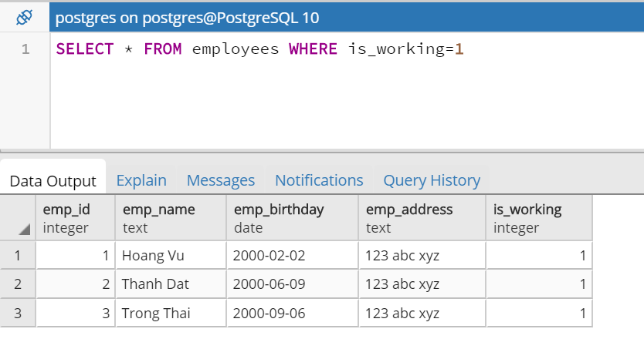
Query Select
Select employees who are working
Is_working ==1 : working

Slide 55
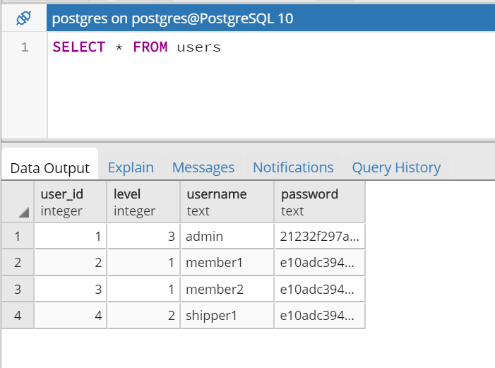
Query Select
Select all account in users list

Slide 56
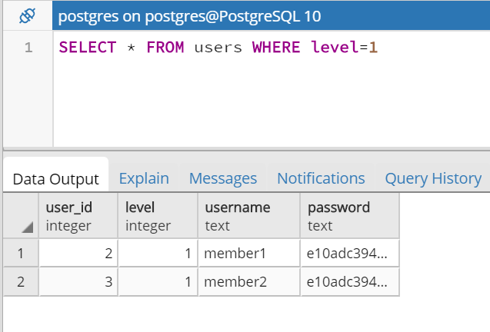
Query Select
Select all accounts in a level , example level : 1

Slide 57
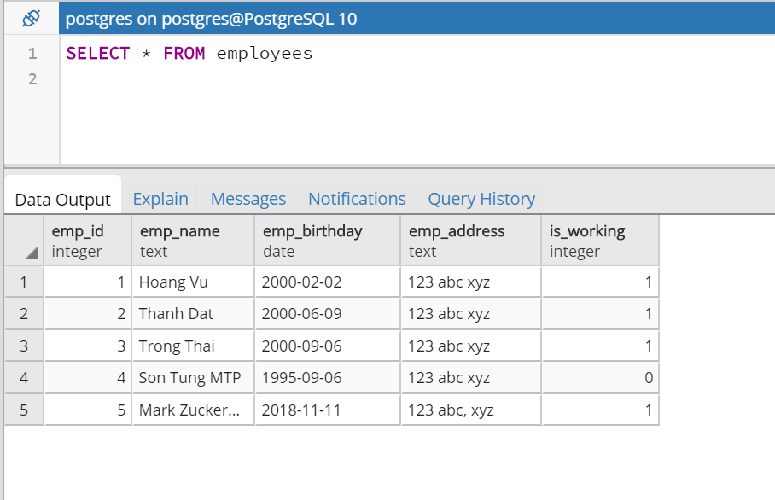
Query Select
Select information of all employees

Slide 58
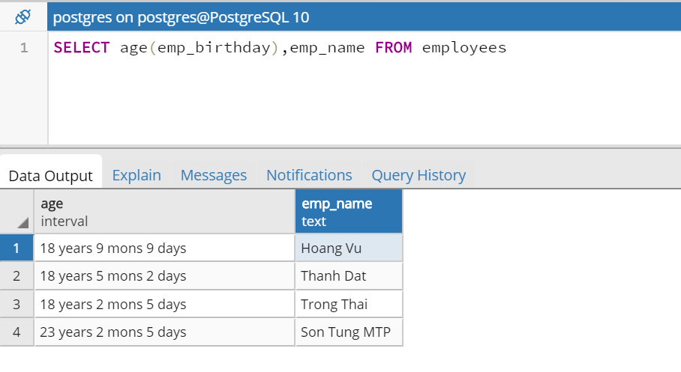
Query Select
Select age of all employees

Slide 59
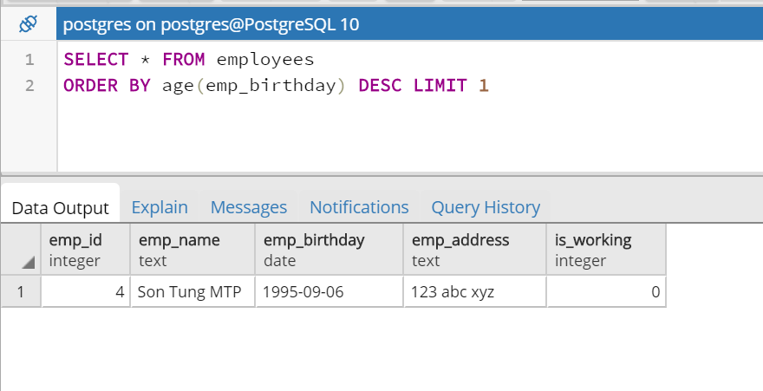
Query Select
Select an employee who oldest in employees list

Slide 60

Query Select
Select employees who have birthday on this month

Slide 61

Query Select
Select employees who have birthday today

Slide 62

Query Select
Select information of all shippers

Slide 63

Query Select
Select information of all orders were ship by shipper (ship_id=1)

Slide 64

Query Select
Select information of shipper who ship the most orders

Slide 65

Query Select
Select information of all customers

Slide 66

Query Select
Select customers who come from ‘Viet Nam’

Slide 67

Query Select
Select country which have the most customers

Slide 68

Query Select
Select employees and count of sold orders

Slide 69

Query Select
Select products and count of reviews

Slide 70

Query Select
Select shippers and count of shipped orders

Slide 71

Query Select
Select customers and count of bought orders

Slide 72

Query Select
Select suppliers and count of supplied products

Slide 73

Query Select
Select all images of product A , example : product_id=12

Slide 74

Query Select
Select total revenue from all orders in database

Slide 75

Query Select
Select total revenue from all orders on a month, example: 11

Slide 76

Query Select
Select total revenue from all orders on current month

Slide 77
Query Select
Select total revenue from selling product A ,example product_id=12

Slide 78

Query Select
Select total count viewers on all products

Slide 79

Query Select
Which category have products were sold the most

Slide 80

Query Select
Select count of reviews which were wrote in a month
example: 11 (Nov)

Slide 81

Query Select
Select count of reviews which were wrote for a product in a month
example: 11 (Nov) , product_id=12

Slide 82
Query Select
Select all suppliers in suppliers li

Slide 83
Query Select
Select all suppliers in suppliers li

Slide 84
Query Select
Select all suppliers in suppliers li

Slide 85
Query Select
Select all suppliers in suppliers li

Slide 86
Query Select
Select all suppliers in suppliers li

Slide 87


Query Update
Edit a category in category list

Slide 88


Query Update
Increment a viewer on a product

Slide 89


Query Update
Update informations of a product

Slide 90


Query Update
Update information of a supplier

Slide 91


Query Update
Update informations of an employee

Slide 92


Query Update
Update informations of a customer

Slide 93

Query Update
Update informations of an order

Slide 94


Query Update
Update informations of a account (Reset Password)

Slide 95


Query Update
Update informations of a shipper

Slide 96



Query Update
Update informations of an order details (update + delete on table orderDetails ) example: order_id=2

Slide 97
Query Update
Update informations of a products

Slide 98
Query Update
Update informations of a products

Slide 99
Query Update
Update informations of a products

Slide 100


Query Delete
Delete a product(product information + images)

Slide 101


Query Delete
Delete a customer

Slide 102


Query Delete
Delete a shipper

Slide 103


Query Delete
Delete a employee

Slide 104
Query Delete
Delete a supplier

Slide 105
Query Delete
Delete employees who stop working

Slide 106
Query Delete
Delete a user in user list

Slide 107
Query Delete
Delete a reset passwork token when it expired

Slide 108
Query Delete
Delete a category and delete all products in this category

Slide 109
Query Delete
Update informations of a products

Slide 110
Query Delete
Update informations of a products

Slide 111
Query Delete
Update informations of a products

Slide 112
Query Delete
Update informations of a products

Slide 113
Query Delete
Update informations of a products

